Slide 1
Final Project Klementinus Kennyvito Salim
BINUSIAN 2022
2201811391

Slide 2
Food for Folks
Final project
Using python as programming language
Using APIs to grab data

Slide 3
What is it?
Has an Interface
Inputting your ingredients
It will open your default browser to a site where all the recipes you can make

Slide 4
How does it work?
It uses Edamam API, tkinter (interface), PIL, webbrowser packages
Needs an internet connection
Open up your browser to view all the recipes.

Slide 5
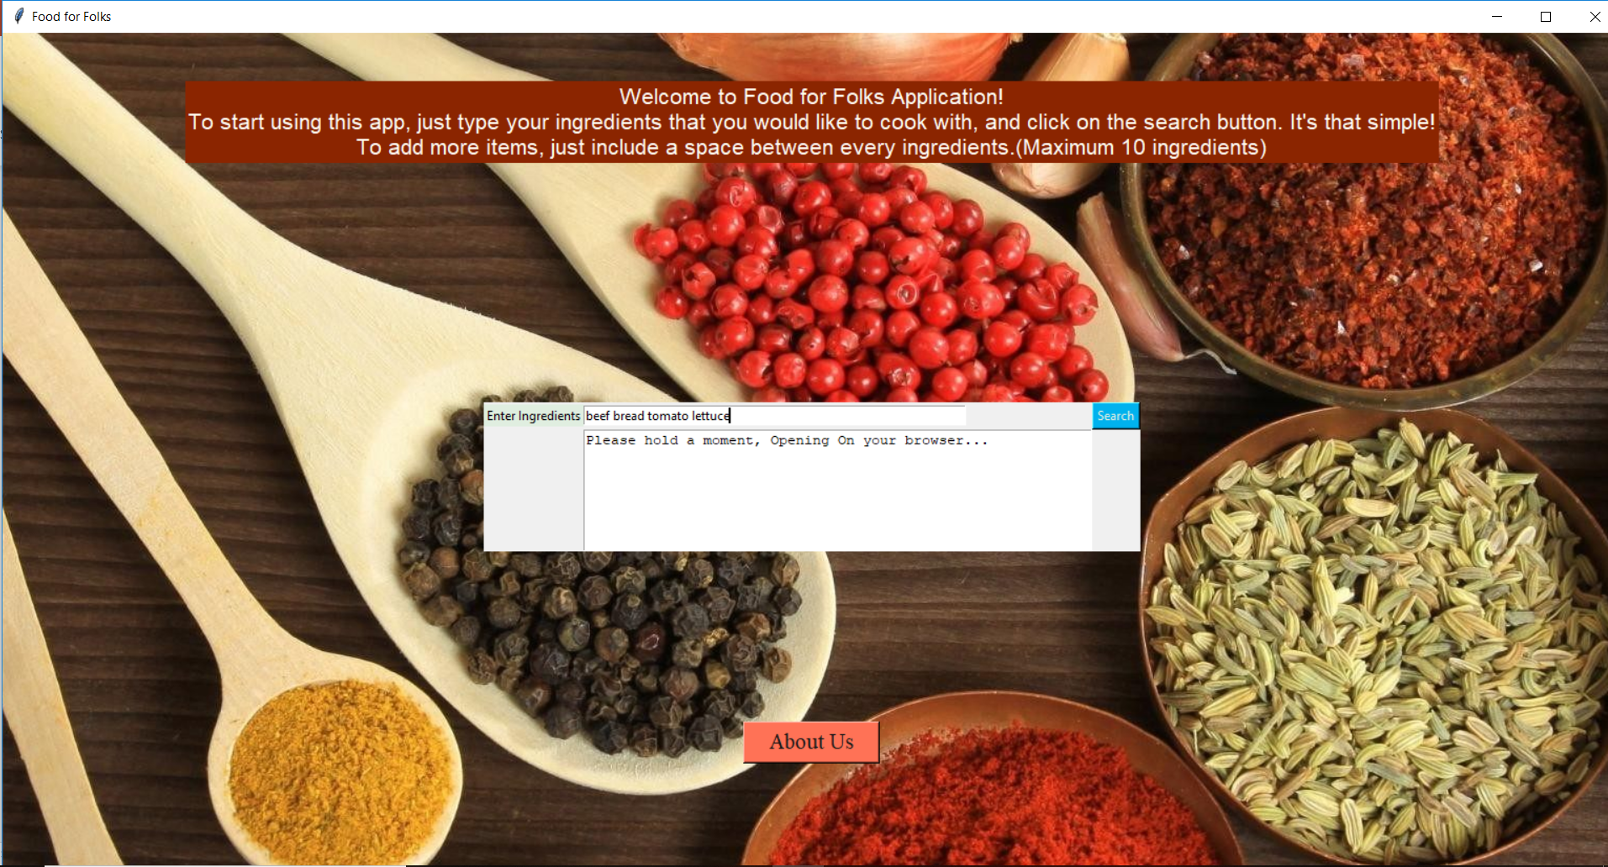
Example:

